Slide 1
Enhanced Recycling Sorter Using DEEP Learning Techniques [CNN]
SAMEER SHAIK

Slide 2
recycling sorter
A recycling sorter is a system or machine that is used in waste management facilities to automatically separate different types of recyclable materials, such as plastics, metals, paper, glass, and others. The purpose of a recycling sorter is to streamline the recycling process, increase efficiency, and improve the quality of recycled materials by reducing contamination. These systems are crucial in helping to manage and recycle waste effectively, thus contributing to environmental conservation efforts.
The Enhanced Recycling Sorter using Machine Learning Techniques with a Convolutional Neural Network (CNN) is a sophisticated system designed to improve the sorting and separation processes in recycling facilities. By leveraging the power of machine learning and specifically CNNs, the system can automatically classify different types of recyclable materials from a stream of waste, ensuring each type is directed to the appropriate recycling process. This technology not only increases the efficiency of recycling operations but also helps in reducing contamination in recyclable materials, which is crucial for maintaining the quality of the recycled output.

Slide 3
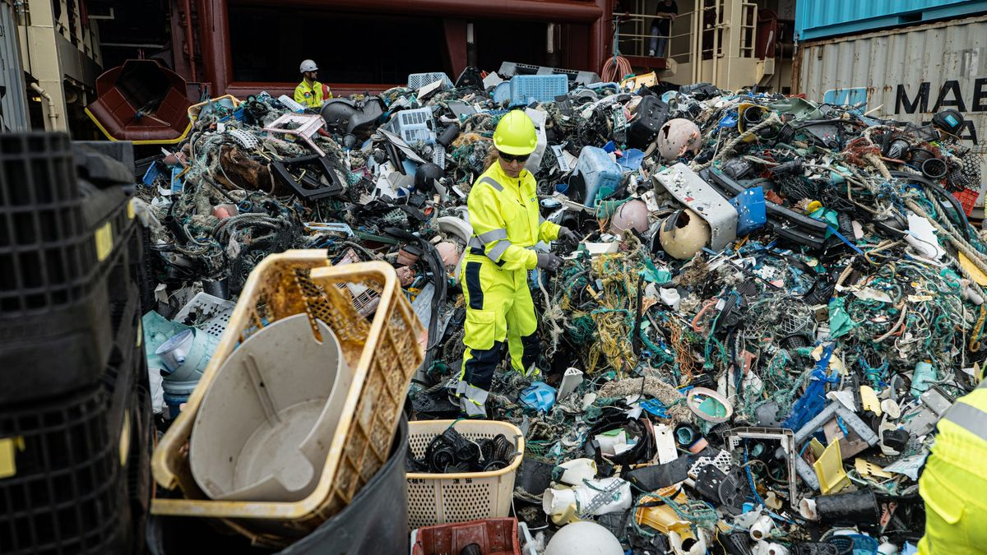
In a scene like the one in image , An enhanced recycling sorter equipped with machine learning and CNNs would autonomously classify and separate the diverse waste materials in the pile, increasing efficiency and purity of recyclables.

Slide 4
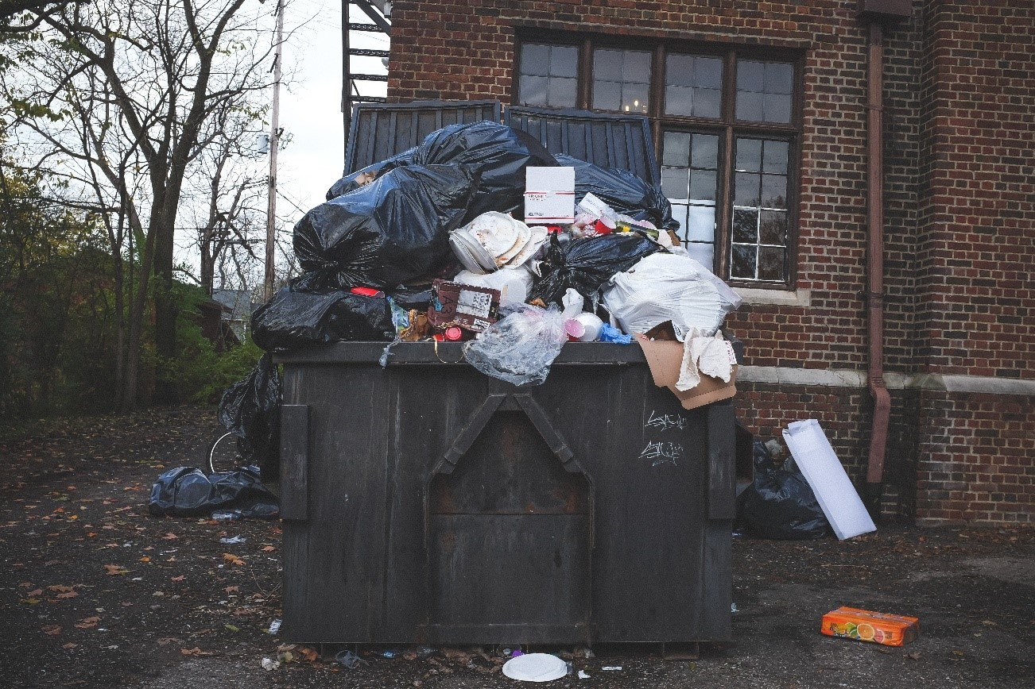
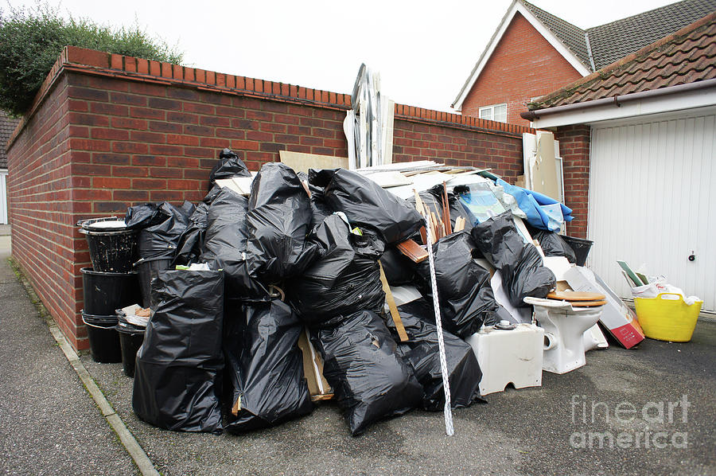
Recycling helps But Not Everyone is Doing
Improper Disposal No Separation
Improper waste disposal pollutes our environment, contaminating soil and water, and poses serious health risks. The absence of waste separation hinders recycling efforts, leading to resource wastage and economic loss. Addressing these issues is crucial for environmental protection and sustainable resource management.
“Sorting Today for a Sustainable Tomorrow”

Slide 5

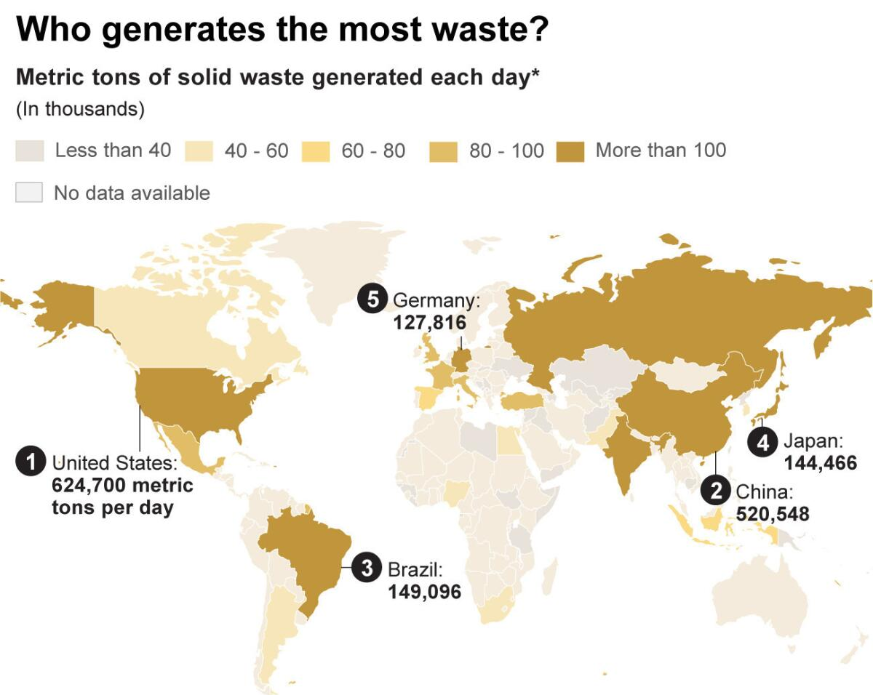
GLOBAL RECYCLING RACE
China's central role in the global waste business based on export data from 2017. It shows the quantity of waste exported from various countries to China, including Hong Kong, with colour coding representing different ranges of metric tons. The United States appears to be the largest exporter, followed by other major contributors such as Japan and Germany. The source of the data is cited as comtrade.un.org, indicating that the statistics are from a UN database.

Slide 6
STEPS:
Train the Dataset and Model
Test the Dataset and Model
Create the CNN Model Architecture
Again Evaluate the Model
Error Corrections
DataSet
Train
Test
Organic
Metal
Glass
Organic
Metal
Glass

Slide 7
DATASET
Taken the accessible dataset from the Mendeley Data, which provides 24,705 images of solid household waste categorized into two classes: organic and recyclable. This dataset has been used in academic research and is accompanied by a Jupyter notebook to help with data augmentation and experimental replication
From Edge Hill University.
The dataset is organized into two categories: organic waste and recyclable waste, with an allocation of 85% for training and 15% for testing. The training set comprises 22,564 images, providing a rich base for the model to learn from. Conversely, the testing set includes 2,513 images, which will be used to evaluate the model's effectiveness in accurately classifying the waste types. This structure allows for comprehensive training and robust testing to ensure the model's reliability in distinguishing between organic and recyclable waste.
https://www.kaggle.com/datasets/techsash/waste-classification-data
https://data.mendeley.com/datasets/n3gtgm9jxj/2
DATASET

Slide 8
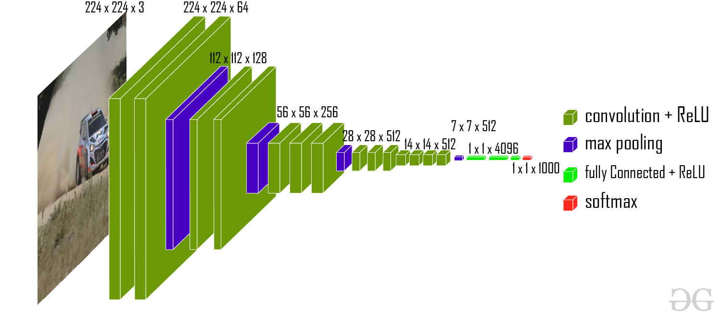
A Convolutional Neural Network (CNN) architecture is a deep learning model designed for processing structured grid-like data, such as images. It consists of multiple layers, including convolutional, pooling, and fully connected layers. CNNs are highly effective for tasks like image classification, object detection, and image segmentation due to their hierarchical feature extraction capabilities.
VGG-16
The VGG-16 model is a convolutional neural network (CNN) architecture that was proposed by the Visual Geometry Group (VGG) at the University of Oxford. It is characterized by its depth, consisting of 16 layers, including 13 convolutional layers and 3 fully connected layers. VGG-16 is renowned for its simplicity and effectiveness, as well as its ability to achieve strong performance on various computer vision tasks, including image classification and object recognition. The model’s architecture features a stack of convolutional layers followed by max-pooling layers, with progressively increasing depth. This design enables the model to learn intricate hierarchical representations of visual features, leading to robust and accurate predictions. Despite its simplicity compared to more recent architectures, VGG-16 remains a popular choice for many deep learning applications due to its versatility and excellent performance.
The ImageNet Large Scale Visual Recognition Challenge (ILSVRC) is an annual competition in computer vision where teams tackle tasks including object localization and image classification. VGG16, proposed by Karen Simonyan and Andrew Zisserman in 2014, achieved top ranks in both tasks, detecting objects from 200 classes and classifying images into 1000 categories.

Slide 9
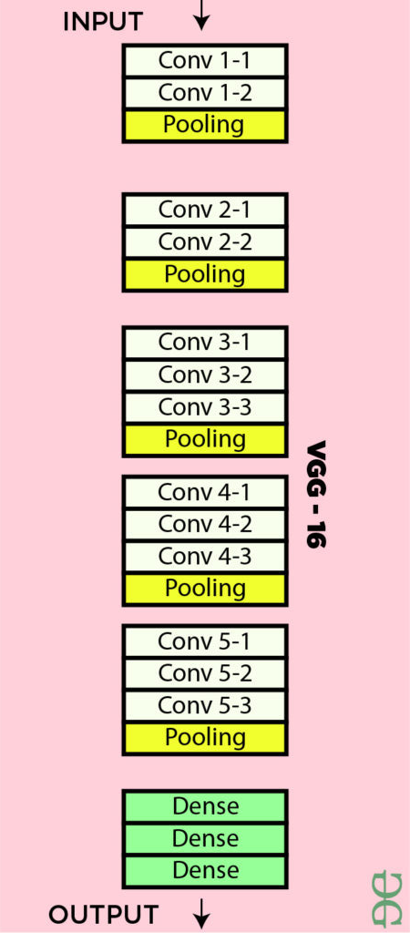
VGG -16 / CNN
Here’s a breakdown of the VGG-16 architecture based on the provided details:
Input Layer: Input dimensions: (224, 224, 3)
Convolutional Layers (64 filters, 3×3 filters, same padding):
Two consecutive convolutional layers with 64 filters each and a filter size of 3×3.
Same padding is applied to maintain spatial dimensions.
Max Pooling Layer (2×2, stride 2):
Max-pooling layer with a pool size of 2×2 and a stride of 2.
Convolutional Layers (128 filters, 3×3 filters, same padding):
Two consecutive convolutional layers with 128 filters each and a filter size of 3×3.
Max Pooling Layer (2×2, stride 2):
Max-pooling layer with a pool size of 2×2 and a stride of 2.
Convolutional Layers (256 filters, 3×3 filters, same padding):
Two consecutive convolutional layers with 256 filters each and a filter size of 3×3.
Convolutional Layers (512 filters, 3×3 filters, same padding):
Two sets of three consecutive convolutional layers with 512 filters each and a filter size of 3×3.
Max Pooling Layer (2×2, stride 2):
Max-pooling layer with a pool size of 2×2 and a stride of 2.
Stack of Convolutional Layers and Max Pooling:
Two additional convolutional layers after the previous stack.
Filter size: 3×3.
Flattening:
Flatten the output feature map (7x7x512) into a vector of size 25088.

Slide 10
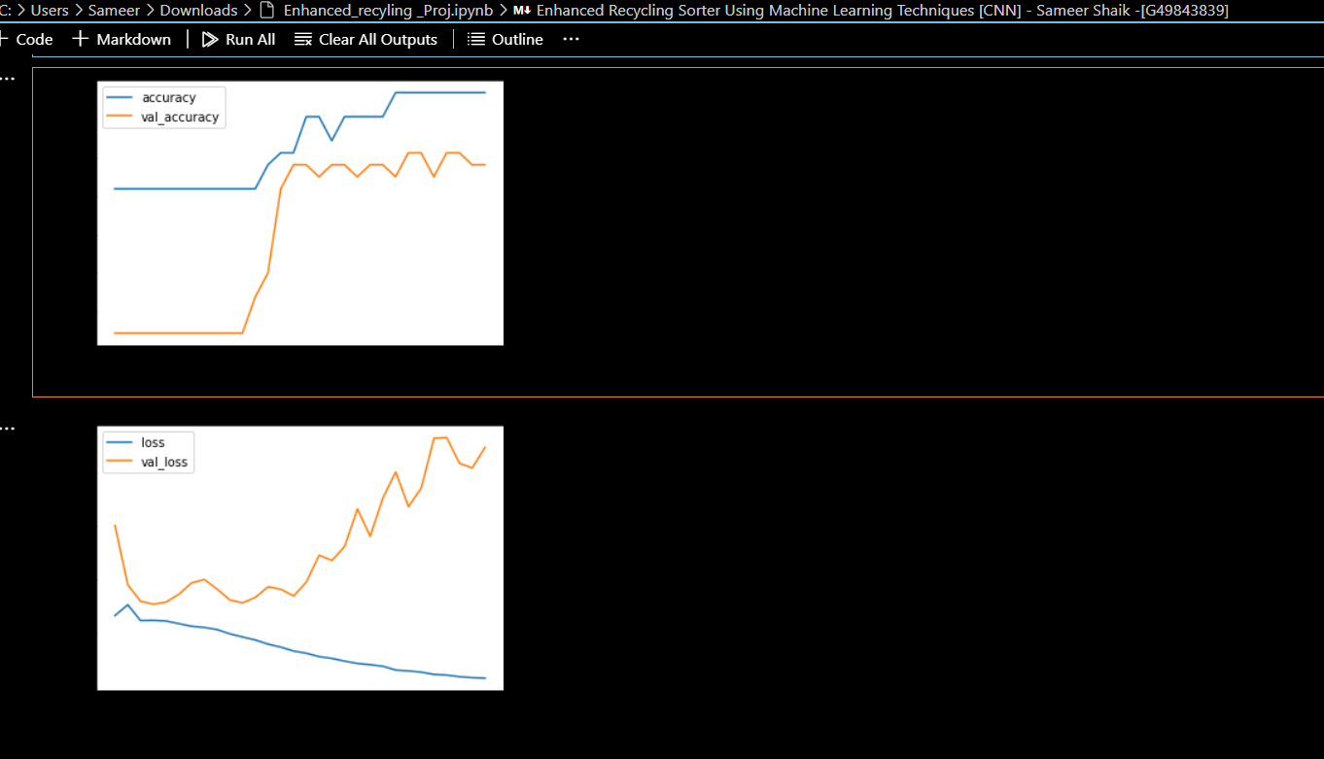
Model 1
We build model with Convolutional Neural Network (CNN) and we will test a few models.
The model consists of three convolution blocks with a max pool layer in each of them. There's a fully connected layer with three Dense layers. First two layers are activated by a relu activation function and the last is activated by a sigmoid activation function.
Compile the model:
Training Accuracy: 0.9688
Testing Accuracy: 0.7812

Slide 11
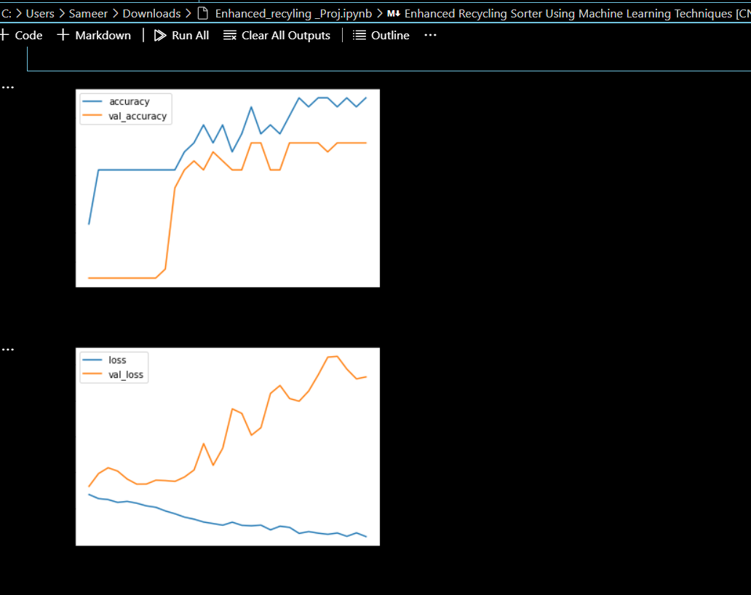
Model 2
In our second model iteration, we're incorporating extra convolution layers and simplifying the architecture of the fully connected layers to enhance accuracy. Additionally, we're integrating Dropout layers to combat overfitting during training, aiming for a more robust model performance.
Training Accuracy: 0.9688
Testing Accuracy: 0.8125

Slide 12
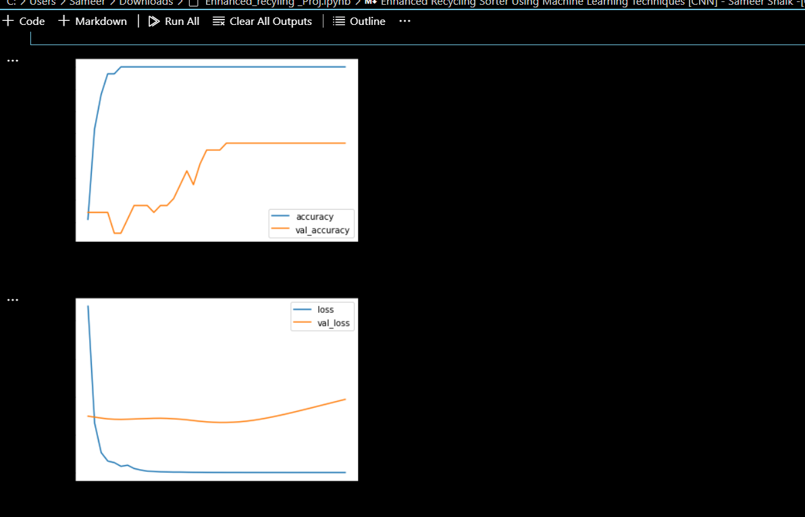
Model 3
It seems Model 2 is outperforming the others in accuracy with your dataset, indicating its superior ability to capture based on the above graph plots. Though I have used the normalization for overfitting to combat overfitting in Model 3, it still exhibits signs of overfitting
Testing Accuracy: 0.6562

Slide 13
CONCLUSION
The first model is structured with three convolutional blocks, each complemented by a max pooling layer. It features a fully connected section consisting of three dense layers, with the initial two layers activated by a generic activation function and the final one by a sigmoid activation function. This configuration resulted in a training accuracy of 96.88% and a testing accuracy of 78.12%.
In the second model iteration, additional convolution layers were incorporated, and the architecture of the fully connected layer was simplified to enhance overall accuracy. Moreover, dropout layers were introduced to address overfitting observed during the training process. These adjustments maintained the training accuracy at 96.88% while improving the testing accuracy to 81.25%.
It seems Model 2 is outperforming the others in accuracy with your dataset, indicating its superior ability to capture based on the above graph plots. Though I have used the normalization for overfitting to combat overfitting in Model 3, it still exhibits signs of overfitting.

Slide 14
THANK YOU
SAMEER SHAIK
G49843839

